Slide 1


Basic CyberSecurity
Nate Lowinger
DECEMBER 1st 2025

Slide 2


Introduction
What is Cyber Crime?
What are Hackers?

Slide 3
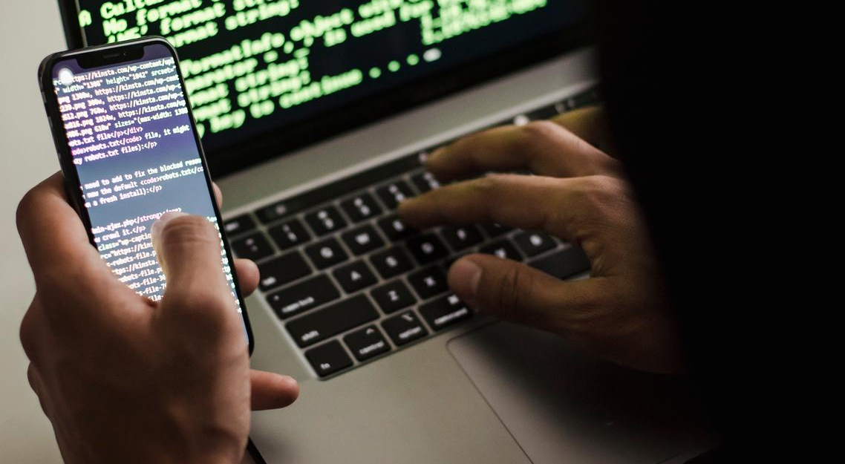




Techniques
Phishing attacks
DNS Poisoning
A social engineering attack wherein the attacker impersonates a trusted source.
A hacker masquerading as a trusted DNS Server that sends you to a malicious link.
Trojans
A malicious application masquerading as a trusted app from a trusted source.

Slide 4
Techniques
Ransomware
Information Stealers
Encrypts your data and holds it “hostage” in exchange for money or cryptocurrency
Steals your data and cookies. Used to steal credentials and gain access to Google accounts. (most common)
Root Kits
Elevates a program or hacker to be an administrator and makes unauthorized changes.

Slide 5

Any Questions

